Slide 1
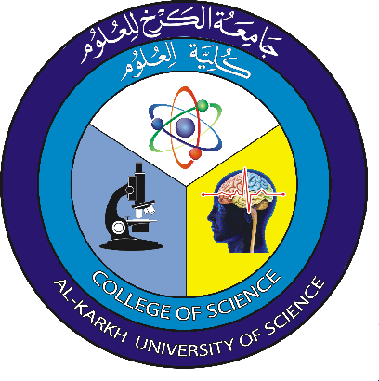
Microscope Dr.Dhuha Bahaa
Light or compound Microscope
Is an instrument with lenses which are used to make really small objects look bigger by magnifying them.
Microscopes have been essential tools of cell biologists; generally there are two types of microscopes:
(A) Light Microscope (LM) which defined above.
(B) Electron Microscope (EM).

Slide 2
Parts of the Light Microscope
Eye or (ocular) piece: where you look through to see the image of your specimen.
Nosepiece: the rotating part of the microscope that holds the objectives
Objective lenses: lenses are varying in length the shortest is the lowest power or magnification and the longest is the highest power or magnification.
Objective Lenses which include:

Slide 3
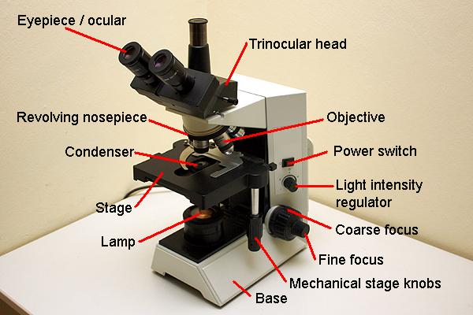

Slide 4
* Low Power Objective Lenses: (4x and 10x)
* High Power Objective Lenses: (40x)
* Oil Immersion (100x)
4- Arm: Use to support the microscope when carried.
5- Condenser: use to focusing light on the tested body.
6- Diaphragm: Regulates the amount of light on the specimen.
7- Stage: large flat area which holds the slide by shiny clips for viewing.
8- Mechanical stage: it allows to move the slide easy by two ways x and y direction.
9-Aperture: the hole in the stage that allows light through for better viewing of the specimen.
10- Course Adjustment (coarse focusing knob) Moves the stage up and down for focusing.
11- Fine Adjustment (fine focusing knob): Moves the stage slightly to sharpen the image.
12- Light Source: makes the specimen easier to see.
13-Foot or Base: Supports the microscope.

Slide 5
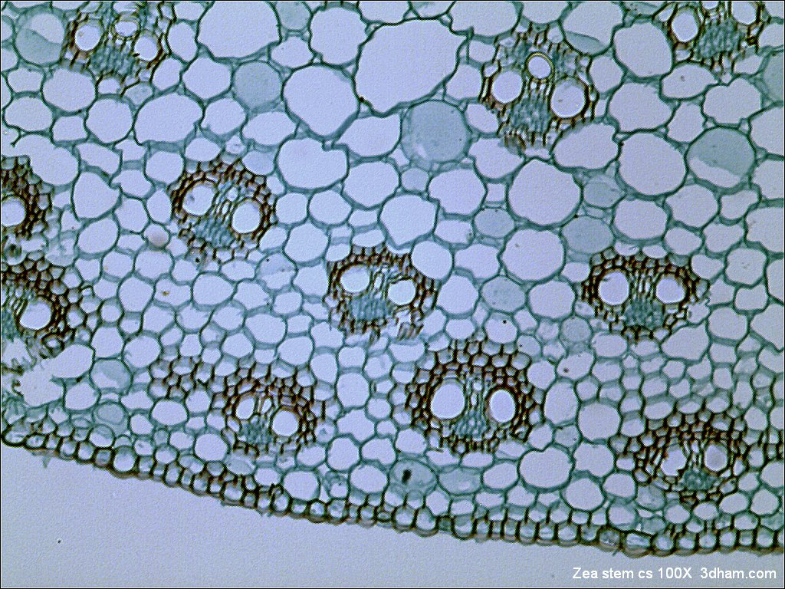
Types of light microscopes:
1-Bright field Microscopes: the most common general use microscope.
Bright field microscopes are named because the microscopic “field” is bright, while the specimen viewed is dark.

Slide 6
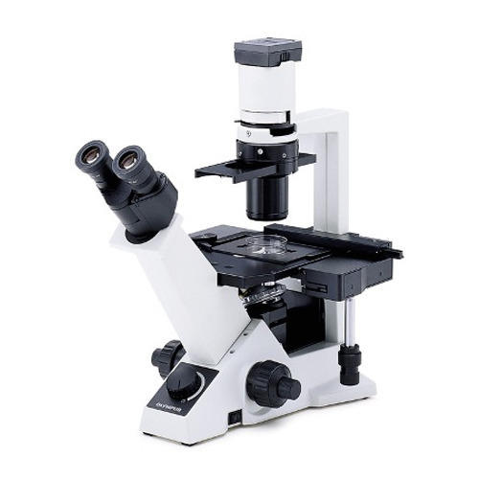
2-Inverted microscope.
Inverted microscopes allow viewing of cells in flasks, welled- plates, or other deep containers that do not fit between the objectives and stage of standard bright field microscope.

Slide 7
3-Phase Contrast Microscope
Can be used to study internal structures of living organisms, No need to fix or stain
Light rays can pass through the specimen and diffracted in different path way.

